Slide 1
Module 2 – Creating Resources
EEPEK
November 2022

Slide 2
OBJECTIVES: upon completion of this module learners will: ● have a be able to create educational Videos and Presentations. ● know and be able to to create Infographics for language learning ● identify and choose the best online tools suits and even enhance them in the online classroom.
1

Slide 3

What is Canva:
2
How to create educational Videos and Presentations on Canva:
Canva is an Australian graphic design platform that is used to create social media graphics and presentations.
The app includes readymade templates for users to use, and the platform is free and offers paid subscriptions such as Canva Pro and Canva for Enterprise for additional functionality. In 2021, Canva launched a video editing tool.
Users can also pay for physical products to be printed and shipped. The company has announced it intends to compete with Google and Microsoft in the office software category, with website and whiteboard products.

Slide 4

Pros & Cons of
2
How to create educational Videos and Presentations on Canva:
Pros
Even a Non-Designer Can Become a Designer Using Canva
Canva is Very Simple to Use and User-Friendly
Canva Provides Social Media Templates
Canva is Budget-Friendly
Canva Offers a Variety of Templates and Elements
Templates Can be Altered to be More Custom
Canva Offers a Professional Look
Canva Offers a Stock Photography Usage
Team Access
Share on Social Media or Schedule
Cons
Canva Style
Limitation on the Number of Templates
Alignment Concerns
Export Settings are Limited
Cannot Download the “Raw” File to Your Computer
The Free Version is Limited
You are Unable to Move One Design to Another Design
Intellectual Property Belongs to Canva
Canva can Delete Your Account at Anytime
Unique Elements Cannot Be Created
Can you think of anymore?

Slide 5
How ro create an educational video on canva:
3
How to create educational Videos and Presentations on Canva:
Ιt’s hard to find tools that are both feature-rich while also being simple enough to roll out to a class full of students in a single period.
Canva for Education, though, is one of those tools. Students around the world are using Canva to create, communicate and demonstrate their learning visually through presentations, posters, comic strips, infographics and more.
Educators and school administrators are creating innovative, supportive and immersive learning environments by designing classroom posters, educational presentations, group projects, newsletters, student certificates, class schedules and other educational resources.
Canva for Education packs in so many possibilities to inspire learning in the classroom!
There are some distinct features that help set Canva’s video tools apart from other video editing options out there as well. Of course, with an education account, all of the Pro features are FREE.
You can set up your educational account here: https://www.canva.com/education/.

Slide 6
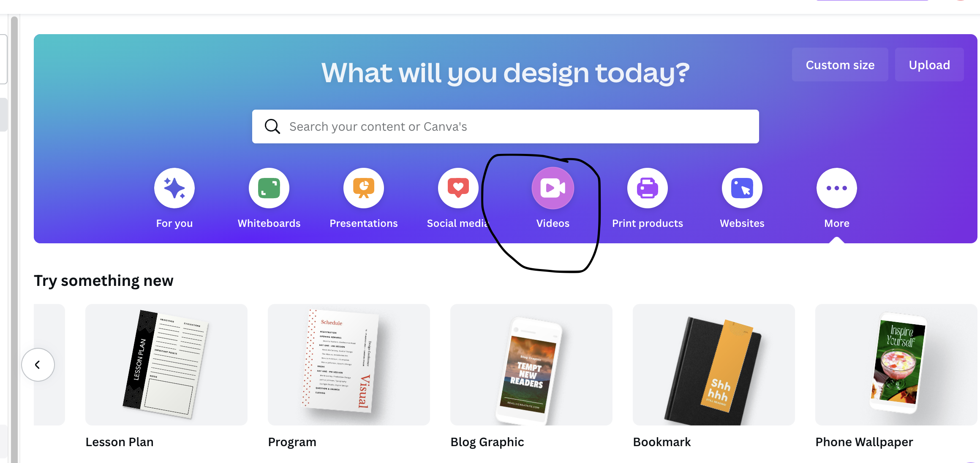
How to create an educational video on canva:
3
How to create educational Videos and Presentations on Canva:
Using the education account to create a video on Canva, you can use the resizing feature to change any video format and dimensions instantly. You also can collaborate on video editing of the same video at the same time as a teammate, colleague, or even a student. Lastly, you can use all of these features and MORE from a mobile device.
With all of these great features, it might be time to check out the video tools inside Canva.
Begin by Starting a New Project
From your Canva homepage, navigate to “Video” and pick out the video type you would like to create (ie: TikTok Video, Video Slideshow, Video Collage, YouTube Video, Instagram Stories, etc.). Once you have chosen your video style, you can choose from the many template options or start from a blank project.

Slide 7
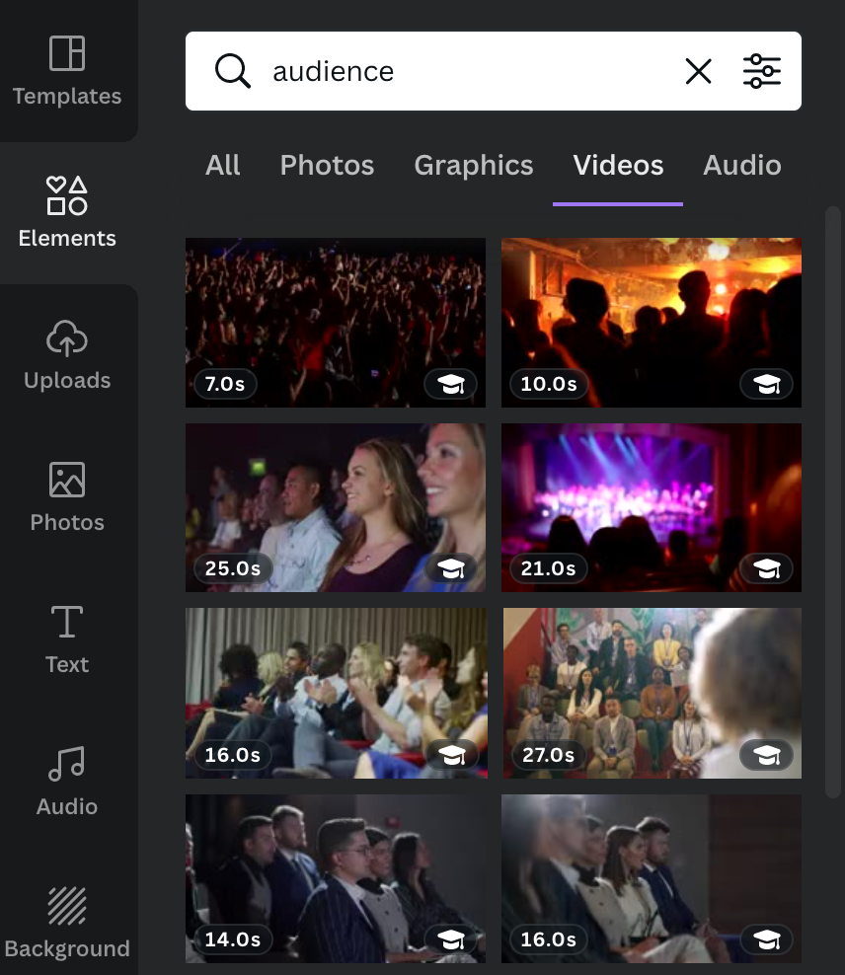
How to create an educational video on canva:
3
How to create educational Videos and Presentations on Canva:
Use Canva Ready-Made Template
Canva has a whole library of video images you can use for creating media, just like with still and animated images. That means you can create a whole video project using stock media without ever having to capture your own video footage. This might be really useful if you are making videos to show to students in your own classroom, making promotional videos for your ensemble or department, creating videos to introduce your group or each song at your concert, or even making advertisements for upcoming events.
You can easily search through videos that are available by using key phrases like “kid playing the flute”, “audience clapping”, “welcome” or other key phrases you might want to include. Make sure to filter your choices by choosing “videos”.

Slide 8
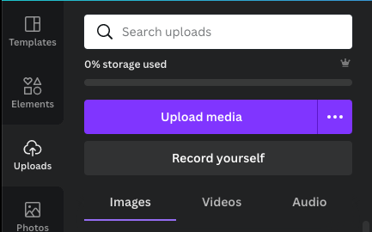
How to create an educational video on canva:
3
How to create educational Videos and Presentations on Canva:
Add Your Own Content
You can also choose to upload your own video media (videos recorded on a separate device) or you can record directly in Canva. Either way, you will need to tap “Upload” on the toolbar located on the left-hand side of the design screen.
Like with other templates, you can personalize the footage to your liking and needs using the editing tools once it is added to your video timeline located at the bottom of the design screen.

Slide 9
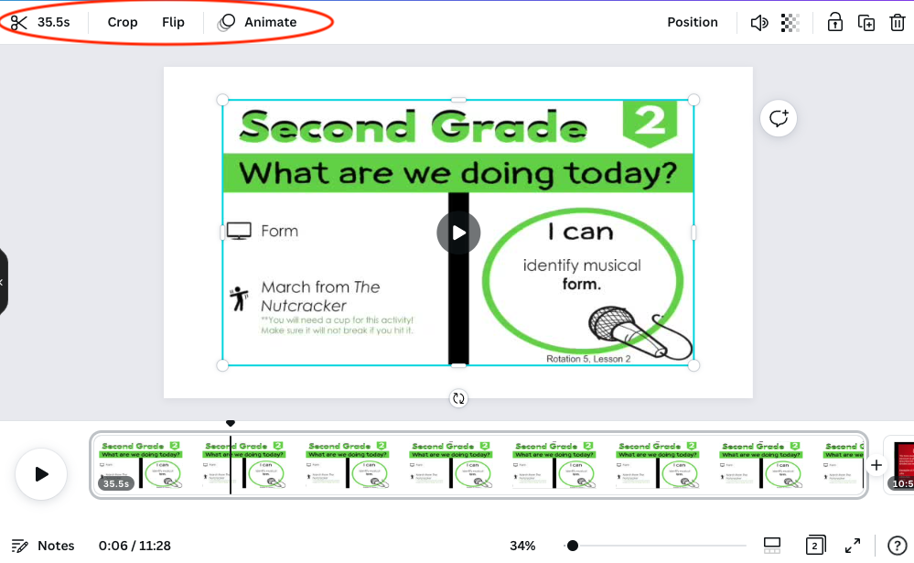
How to create an educational video on canva:
3
How to create educational Videos and Presentations on Canva:
Edit Your Content
There are so many options for making your video media perfect in the editing process with no editing experience required! In fact, if you are familiar with Canva, many of the tools work much the same.
Here are a few quick tips to help you get started.
To crop, trim, flip or animate your video:
Click on the video in the design space. A toolbar will appear at the top of the screen to make these adjustments.

Slide 10
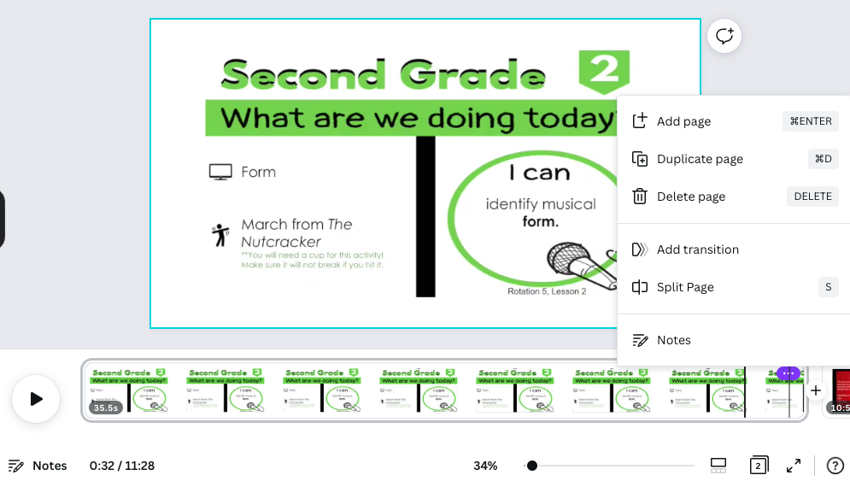
How to create an educational video on canva:
3
How to create educational Videos and Presentations on Canva:
Edit Your Content
To add a transition between clips or split, add, duplicate or delete a clip:
Select the clip to make the 3 dots appear in the corner. Click on the three dots to make the desired adjustment.
To add background music:
You can either upload your own audio or use any track that is available under the Audio tab on the left-hand toolbar.
To make any adjustments to the audio, you can select the button that appears just above the timeline on the design screen.
This includes, but is not limited to:
Volume
fade in/out
splitting (or duplicating) audio
To add text or other elements to your video:
Use the menu on the left-hand toolbar to add to any video clip, just like you do with other media in Canva! This includes any of the animated graphics available in the elements tab.

Slide 11
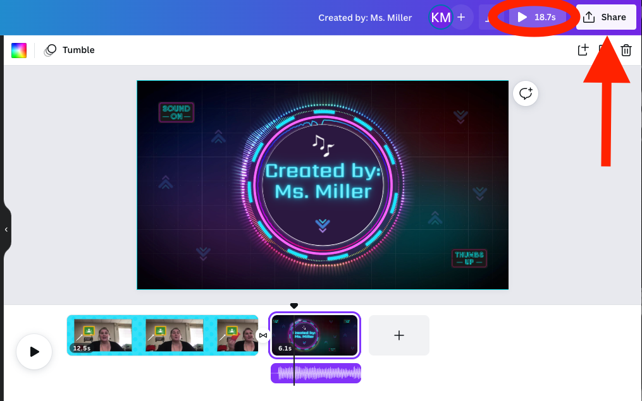
How to create an educational video on canva:
3
How to create educational Videos and Presentations on Canva:
Preview and Share Your Video
When you are ready to preview your work, click the triangle, or play button, in the top, right-hand corner of the design screen. If everything looks great, you can share your video with others.
Some options for sharing are downloading as a watermark-free MP4, creating a link for others to view the video, or posting it directly to your linked social media accounts.

Slide 12
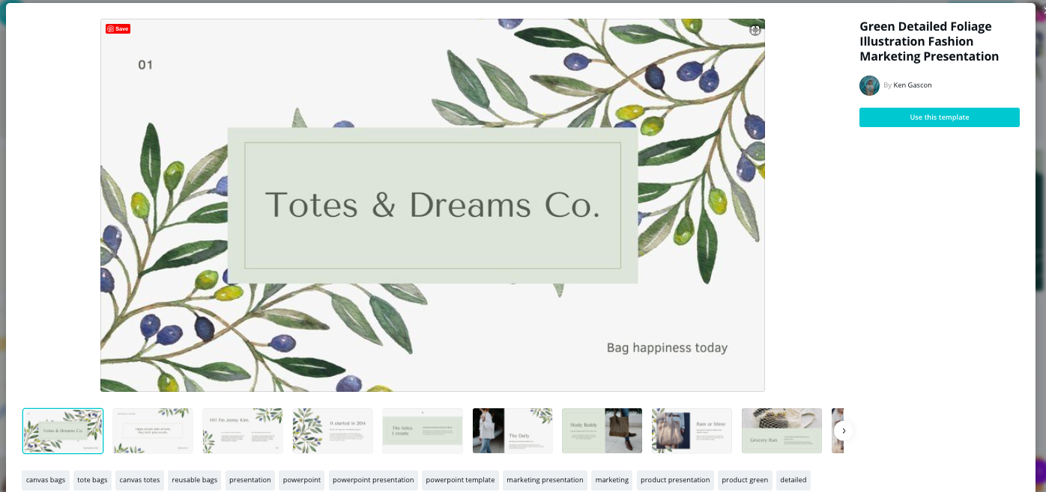
How to create a presentation on canva:
3
How to create educational Videos and Presentations on Canva:
Canva can be used for presentations by both individuals and small teams and any large business seeking an integrated tool to create high-quality visuals for their brand. With a library of built-in templates and easy drag-and-drop tools, Canva makes it simple for anyone to make their own design with beautiful visuals.
Why You Should be Making Presentations on Canva
Canva isn’t only to create and download designs like a logo or icons. Canva also has presentation tools to add visual interest to your slideshow designs.
Here are four more reasons:
Simplicity. Canva is free and easy to use. Canva pro is free during their 30-day trial.
Saves time. You can create professional-looking presentations in minutes.
Customization. There are thousands of templates and designs to choose from.
Easy to share. You can easily share your presentations with others and on social media.

Slide 13
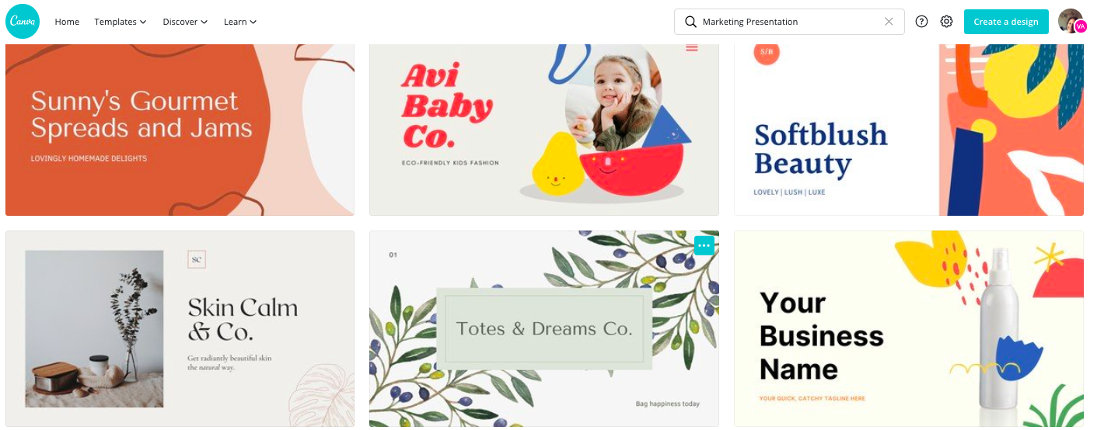
How to create a presentation on canva:
3
How to create educational Videos and Presentations on Canva:
How to make a presentation
Make your slides stand out
Browse millions of images and elements, experiment with layouts, find the right font combination and color scheme for your presentation. Add animations, videos and music for a truly engaging presentation.
Present with flair
Try out the various presentation modes and features on Canva. Choose from standard presentation, presenter mode, video recording. Or, on bad hair days, choose an audio-only video presentation mode. Save your slides as a PDF for handouts, export them as PowerPoint .pptx files, or turn them into an interactive website!

Slide 14
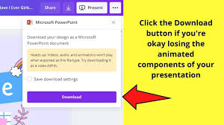
How to create a presentation on canva:
3
How to create educational Videos and Presentations on Canva:
How to make a presentation
Make your slides stand out
Browse millions of images and elements, experiment with layouts, find the right font combination and color scheme for your presentation. Add animations, videos and music for a truly engaging presentation.
Present with flair
Try out the various presentation modes and features on Canva. Choose from standard presentation, presenter mode, video recording. Or, on bad hair days, choose an audio-only video presentation mode. Save your slides as a PDF for handouts, export them as PowerPoint .pptx files, or turn them into an interactive website!

Slide 15

4
How to create educational Videos and Presentations on Canva:
How to make a presentation
Use images from our professional stock library or upload your own
Our amazing library of over 1 million stock images, graphics and illustrations will enhance your presentation and make it look more professional. Many of these images are free while premium images are offered at a very competitive price.
It’s free to customize your presentation with your own images.
Once you upload them into Canva’s free presentation software you can use them as many times as you like.
Brand your presentation for work
Upload your company logo, save your company colors and choose from over 120 fonts to brand your presentation for work. You can share with your branded presentation with your colleagues so they can use it as a layout to create their own presentation in Canva.

Slide 16

4
How to create educational Videos and Presentations on Canva:
How to make a presentation
Choose from professionally designed layouts or create your own
We’re proud of our extensive library of layouts which make it amazingly easy to create professional presentations with ease. You can use our selection of presentation layouts as many times as you like or create your own unique layout by duplicating an existing design.
Collaborate with your team in real-time
Whether you’re creating a presentation for the boardroom or the classroom, creating and collaborating on presentations with Canva is simple. To create a team, simply choose those who you would like to collaborate with and once the invitation is accepted you can instantly start creating your presentation together. Play with illustrations, colors, leave comments, and resolve suggestions all within the Canva editor. Teamwork is made easier with Canva’s presentation tool.

Slide 17
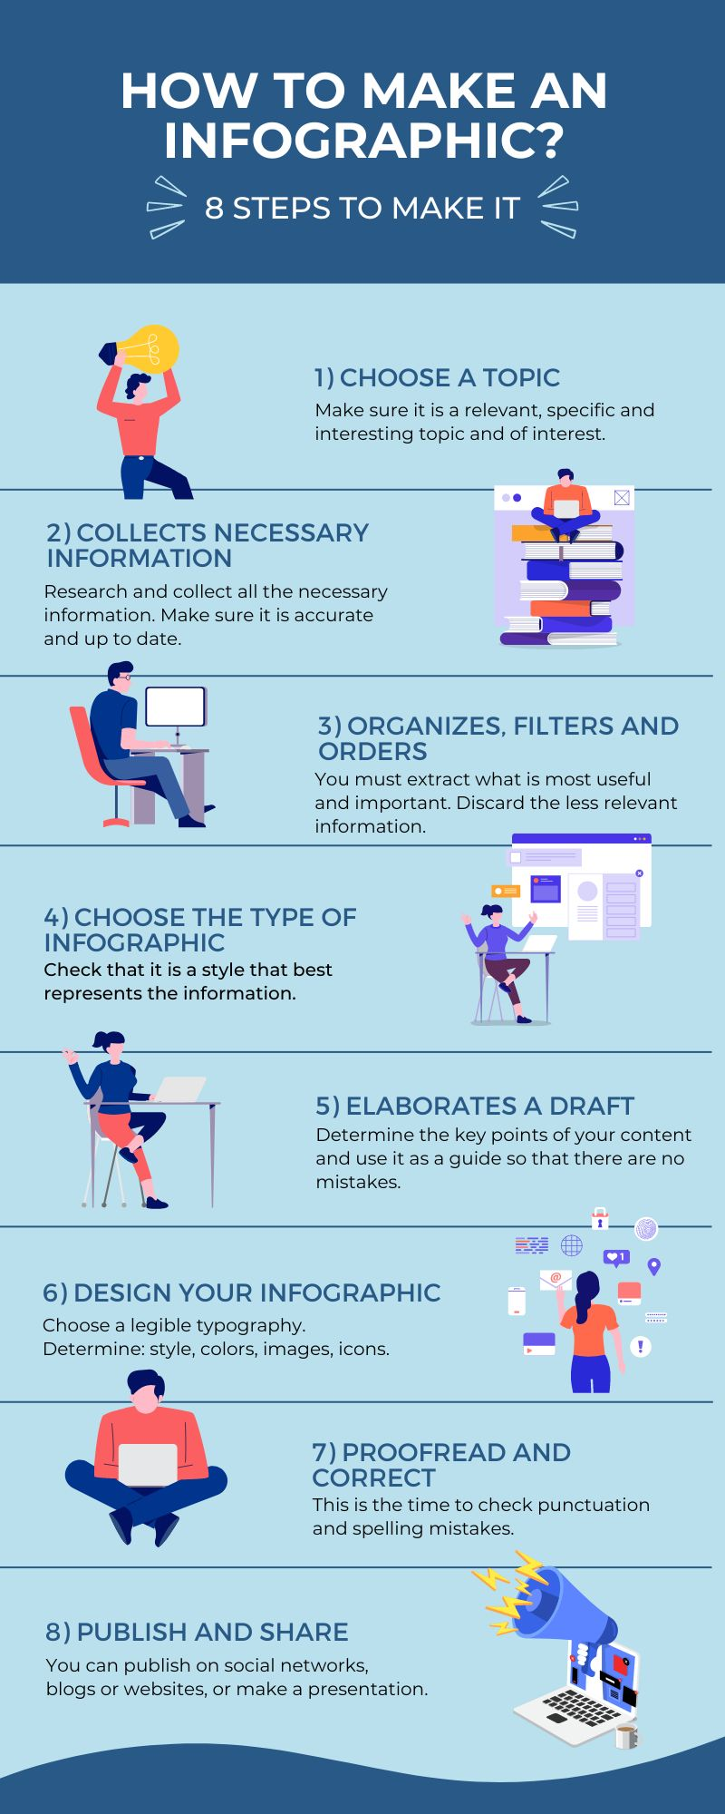
4
How to create Infographics on Canva:
1. Search for Infographic Design Templates
Caveat Brush Canva Font
Search for the ‘Infographic’ on the search bar or you can go with the ‘Infographic’ option from the ‘Create Design’ menu.
2. Choose Your Inographic Template
Caveat Brush Canva Font
You can select any of the templates available for free! If you are a pro user, you can also choose the exclusive templates by paying for them.
3. Edit Infographic Elements
Playfair Display Black Font Pairing
Edit the template according to your requirements. You can change everything – Text, Fonts, Colors, Elements! You can also change the background colors and adjust everything that goes with your business!
4. Download Finished Infographic
Playfair Display Black Font Pairing
After done editing the complete infographic, all you need to do is to download it and use it wherever you want!

Slide 18
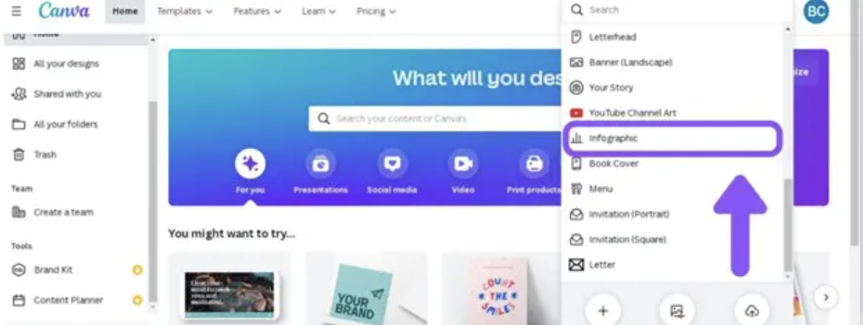
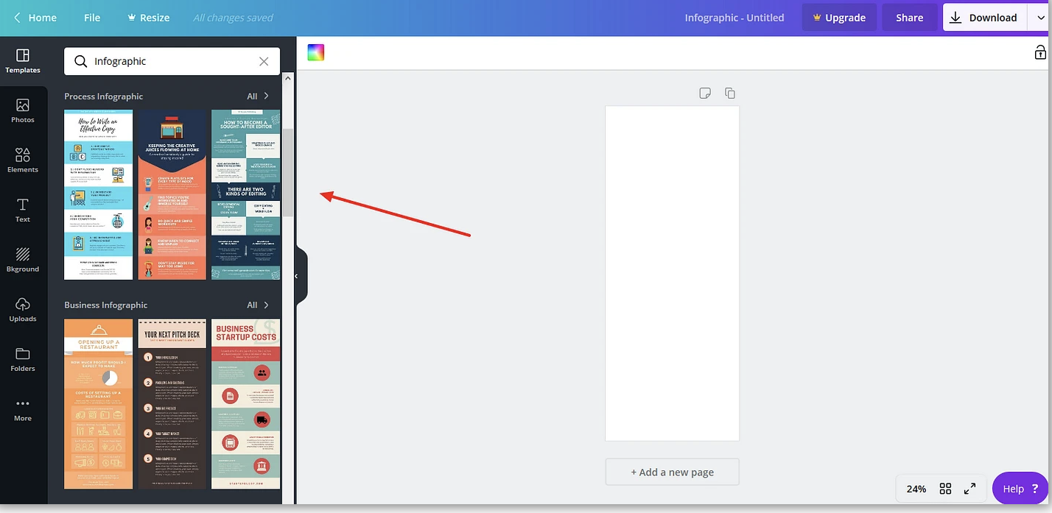
4
How to create Infographics on Canva:
Search for Infographic Design Templates
Search for the ‘Infographic’ on the search bar or you can go with the ‘Infographic’ option from the ‘Create Design’ menu.
Choose Your Infographic Template
You can select any of the templates available for free! If you are a pro user, you can also choose the exclusive templates by paying for them.
After you’ve chosen the right size canvas for your project, Canva rolls out a list of layout options that will serve as the base of your infographics. There are literally hundreds of designs to choose from, but the first 50 are typically the most customizable.
Canva offers both free and premium design templates, but the vast majority in this category are free to use. Each template has a variety of options based on the type of data being displayed, the visuals used intended for the design.
=

Slide 19
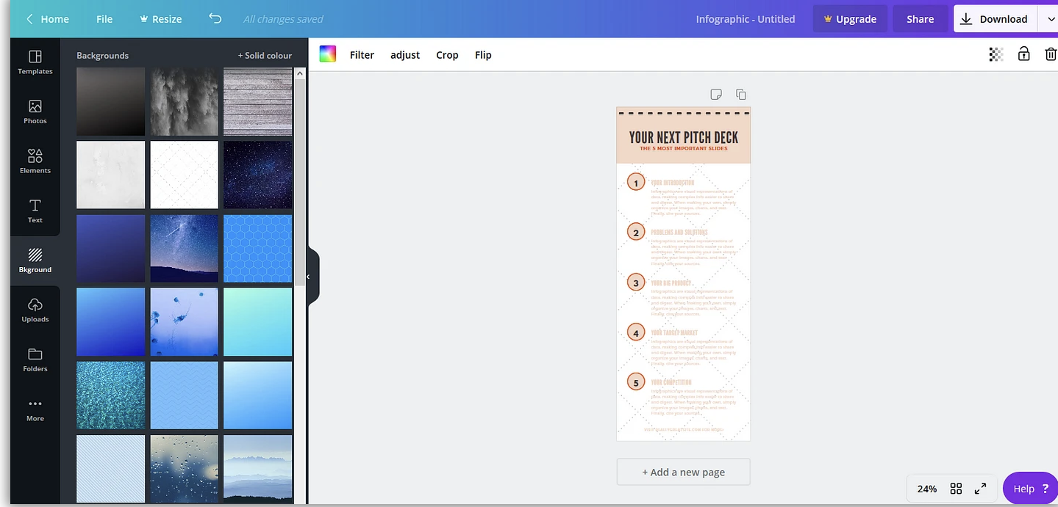
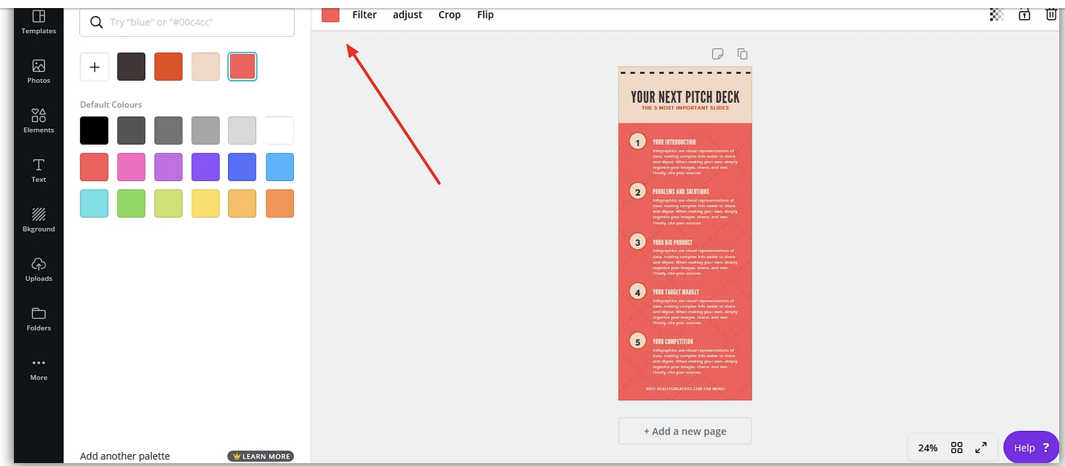
4
How to create Infographics on Canva:
Edit Infographic Elements
Edit the template according to your requirements. You can change everything – Text, Fonts, Colors, Elements! You can also change the background colors and adjust everything that goes with your business!
Now that you’ve selected a stunning template, it’s time to choose an eye-catching background. Canva provides unique infographic skins for free, and you can pick from a library of different patterns, colors, and design elements.
To change the background, click on the background icon in the left sidebar. The background options are sorted by color and include everything from solid colors and macro-photography, to quirky sketches and minimalist patterns. Choose one that aligns with your brand.

Slide 20
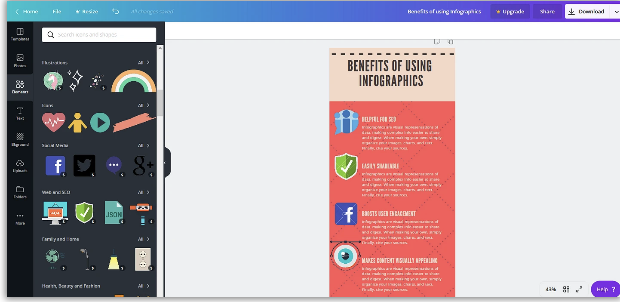
4
How to create Infographics on Canva:
Add graphical elements
The ease at which Canva lets you add graphic elements is a big reason why we decided to choose Canva for our ‘how to create an infographic’ guide. Infographics are so effective because they use powerful imagery to convey key data points. Be sure you’re picking relevant images to represent your info.
Canva has categorized its graphical elements into “images”, “grids”, “charts”, “frames”, “shapes”, “illustrations”, and “icons”. Under the “elements” tab, you will find an icon for just about every niche. To give you a feeling of the variety, we have created our infographics using some of the elements available in Canva
Download your file
When you’ve settled on the perfect design for your infographic, click the download button to bring up a list of file types.
Adjacent to that button is the sharing and dowload options.

Slide 21


6
Additional features Resources:
Another useful tool to create presentations, games and useful material for your online class is Genially!
It is a web-based tool, available in a free version, that allows you to create animated infographics, interactive presentations and even escape games. You can use this tool to present content to your students in a fun way.
Or offer it to your students as a visual aid during their oral presentations.

Slide 22

12
Key Takeaways:
Research different platforms, which one best suits your needs?
When you have chosen your platform, ensure you understand all of its features – watch videos, read instructions & talk to others who already use the same platform.
Use your creativity!

