Slide 1
Module 1:
Online teaching platforms
Eurospeak Limited
November 2022

Slide 2
Objectives: upon completion of this module learners will:
● have a better understanding of some of the different types of online teaching platforms and how they function.
● know and be able to sufficiently use the basic tools required for online teaching.
● identify and choose the best background to suit and even enhance your classes.
-
1

Slide 3

Online teaching has a vast array of benefits, but equally, there can also be a downside too. See below for some examples of both.
2
Advantages & Disadvantages of online teaching:
Disadvantages:
Excessive screen time.
Technical equipment – poor internet connection / lack of microphones etc.,
Isolation.
Lack of available training to deliver optimum quality lessons.
More difficult to build rapport in online classes.
Advantages:
Work from anywhere.
Reduced costs – No office / travel etc.,
Reach a wider student base.
Greater flexibility of working hours.
More free time.
Better self – discipline.
Can you think of anymore?

Slide 4
Below is some vocabulary related to online teaching. Can you match the vocabulary with the correct definitions?
3
What do you already know? Useful vocabulary.
Vocabulary : | Definitions:
1. Breakout room | A) A set of letters and numbers that identify a particular class.
2. Screen Share | B) A tool that allows participants to send instant messages during meetings.
3. Chat | C) A tool that allows the host to separate participants into smaller groups.
4. Whiteboard | D) A background that is used for adding text / images to.
5. Class code | E) A tool that allows the host or the participants to share documents / images etc., with the whole group.
Correct answers: 1 – C / 2 – E / 3 – B / 4 – D / 5 – A.)
Now look at the list below. Which do you think are platforms that are commonly used for teaching online?
Zoom.
Microsoft Teams.
Facebook.
Netflix
Google classroom.
(Correct answers: 1 / 2 & 5 are all platforms which can be used for teaching online. Facebook is a social networking site & Netflix is a video streaming site.)

Slide 5
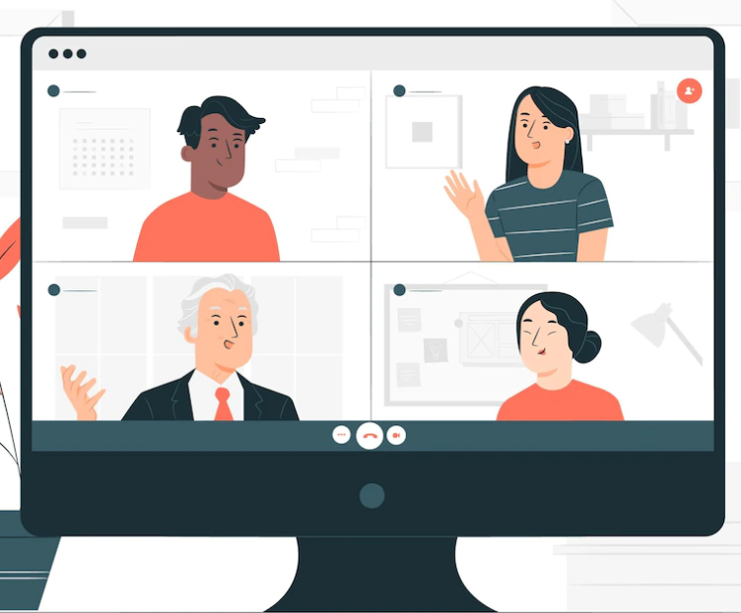
Zoom!
4
In a nutshell – Zoom!
What is Zoom?
Using the words below, read the following text and complete the missing gaps:
Receive, Schedule, Smartphone, Online, Connection, Communications
Zoom is a 1.____________ platform that lets users meet together 2.__________ and share video, audio, phone and chat. To use Zoom you need an internet 3.______________ and a device which can support Zoom, such as a laptop, a 4.____________ or a tablet. Users need to create an account and download the software. Once you have this you can 5.___________ ‘meetings’ for your students to join classes. Once you schedule your meeting you will 6.___________ an invite link which can be emailed to your students.
Correct answers: 1 – communications / 2 – online / 3 – connection / 4 – smartphone / 5 – schedule / 6 – receive.

Slide 6

5
How to use Zoom
Which of the following is NOT an option on the Zoom homepage?
Join
Previous meeting
New meeting
Schedule
Share screen.
If you want to join a meeting, which of the following TWO can be used to join the meeting?
Zoom password
Google I.D
Meeting I.D
Facebook login
Personal link name.
3. Initially you may have problems with what?
Audio
Chat
Video
4. What happens when you ‘hold’ your space bar?
Zoom shuts down
You unmute yourself
You can share your screen
5. The ^ button next to the camera button allows you to:
Use a virtual background
Turn your camera off
Mute your microphone
6. Which ‘view’ is better for bigger groups?
Speaker view
Gallery view
7. What type of learners might benefit from ‘snap camera’ ?
Young learners
Adults
Watch the Video ‘Zoom for Dummies! And answer the questions:
https://www.youtube.com/watch?v=iagJnvy6lLY

Slide 7

6
Zoom Break out rooms:
Zoom also has the ‘breakout room’ feature. When it comes to delivering online lessons break out rooms are an invaluable tool for allowing your students to be broken into smaller groups and collaborating on team tasks. The rooms are isolated from one another and the groups cannot hear or see each other. The host or teacher is able to move between rooms to monitor each group and assist where needed.
Break out rooms have many reported benefits for students, particularly for less - confident students who feel uncomfortable speaking during the main sessions. They can also help keep learners engaged during sessions. During the main session students are typically more likely to suffer increased boredom when compared to a traditional classroom setting, however the use of breakout rooms can offer opportunity for students to become re – engaged and a chance for one – to – one with the teacher.
Breakout rooms can be used for:
Smaller conversations / discussions.
Collaboration.
Preparation for tasks / games.
For more information on how to use break out rooms – see the ‘wikihow’
instructions below
https://www.wikihow.tech/Add-Participants-to-the-Breakout-Room-in-Zoom

Slide 8

7
Google classroom:
Google classroom is another popular tool used for teaching online. Read the statements below about google classroom and decide which ones you think are TRUE:
You can use Google classroom with Gmail, Google Docs and Google Calendar.
Google classroom was the first ever teaching platform.
Google classrooms allows you to create individual classrooms for each group of students.
You can post assignments and communicate with students using google classroom.
You have to pay to use Google classroom.
You invite students using a class code.
Googe classroom includes a ‘stream’ where teachers and students can communicate.
Google classroom grades student’s assignments whilst you relax.
(Answers: 1, 3, 4, 6, 7 are TRUE)

Slide 9
8
How to use Google Classroom.
The link below provides short videos to using Google classroom. Watch each video in turn and then tick off each section when you understand the steps.
https://edu.google.com/intl/ALL_uk/for-educators/product-guides/classroom/?modal_active=none
What is Google Classroom?
Accessing Google Classroom.
Adding Students to a class.
Viewing the stream page.
Viewing the classwork page.
Viewing the people page.
Creating assignments.
Providing feedback and grades.
Next check your understanding with the following true or false Quiz:
Google Classroom is an easy to use tool that helps teachers manage coursework. (T)
You don’t need a Google account to use Google classroom. (F) You DO need to set up a google account to access Google Classroom
You can invite students using their e-mail addresses or by sharing the class enrolment code (T)
There are different sections for each class including Stream, coursework, people and grades. (T)
You can’t add course materials or create quizzes on Google classroom. (F) You can do both on Google classroom.
You can e-mail students and parents through Google classroom. (T)
You can link Google drive and You tube to Google Classroom (T)
You can’t access individual student's progress on Google Classrooms (F) You can access this information under the student work tab.

Slide 10

What is Microsoft teams?
Read the text below, each sentence has two optional words – as you read, choose the most appropriate word.
9
Microsoft Teams:
interact/disagree, account/profile, hospitals/businesses, benefits/hinderances, 365/356
Microsoft teams is part of the Office 1. 365 / 356 programme suite. It is a popular cloud - based tool used for collaboration and conferencing. Originally teams was aimed at 2. hospitals / businesses, however subsequently to the pandemic, other industries began to realise the 3. benefits / hinderances that Teams could bring to their organisations, particularly those in the field of education, from schools to universities to freelance private tutors. Much like Google Classroom, Microsoft teams allows joined users to 4. interact / disagree. Teams allows users the opportunity to make each ‘channel’ either private or public, with the public channel open to all participants of a particular project and the private channel only open to selected members of a particular project. As with the other platforms we have considered in this module you need to sign into an 5. account / profile, You can use your existing Office 365 account for this.
(Correct answers: 1 – 365 / 2 – businesses / 3 – benefits / 4 – interact / 5 – account.)

Slide 11
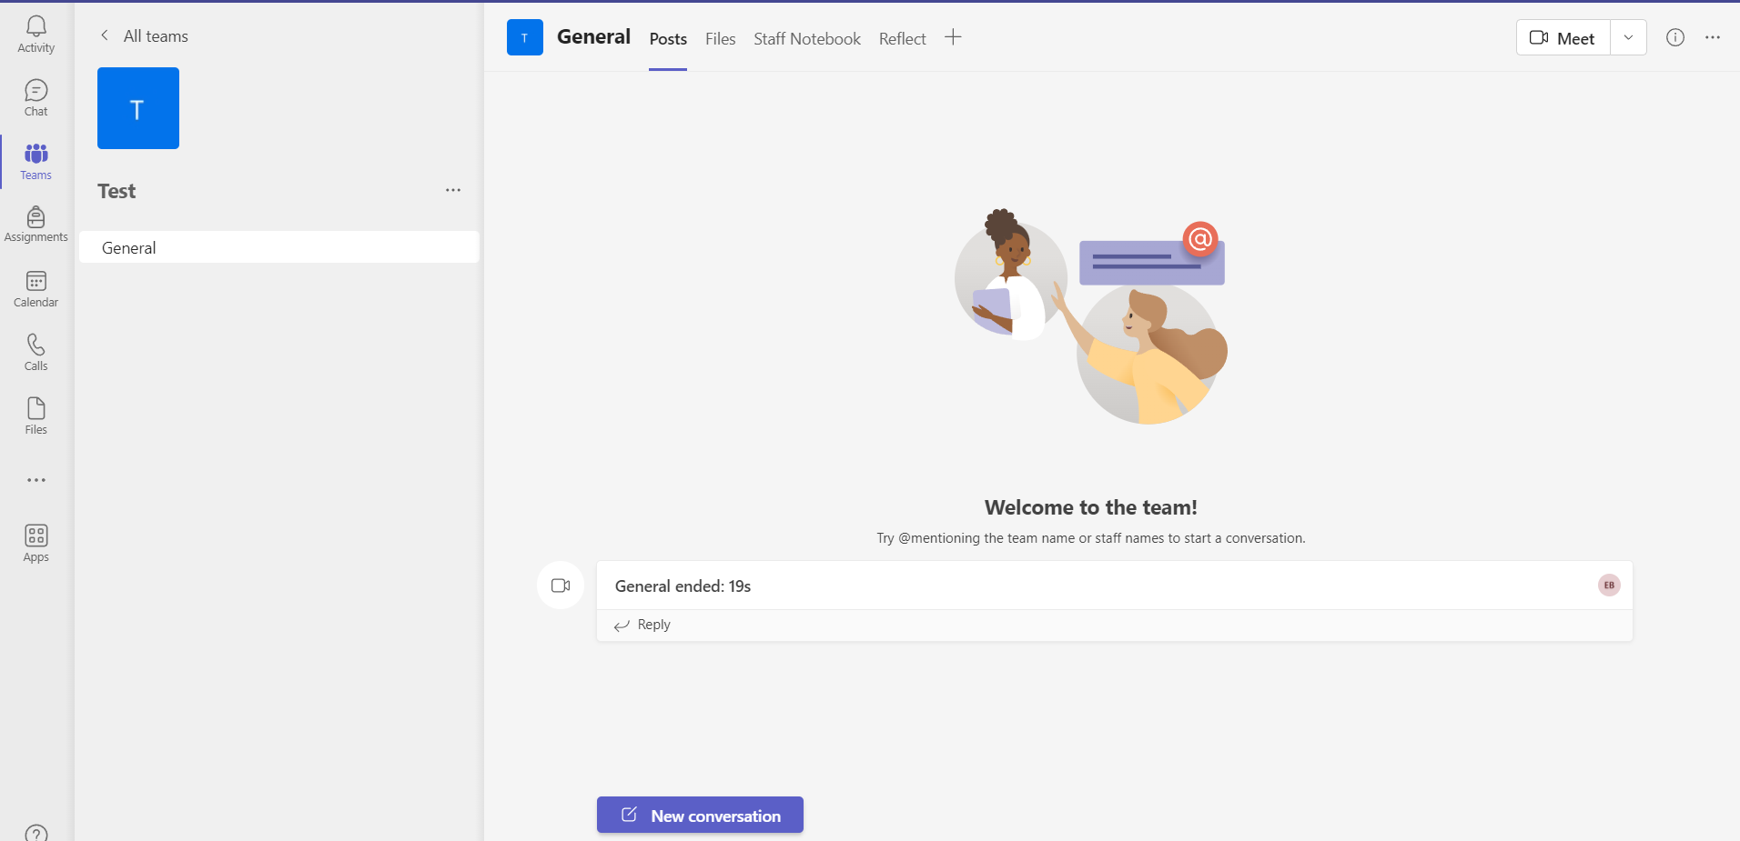
Once you have logged in to Microsoft teams, you should have something that looks like this:
10
Microsoft Teams:
Key features of Microsoft Teams:
Chat – for chatting with the entire team or individuals
VOIP calls to team members
Video conferencing
Screen sharing
Calendar
File sharing
Webinars
External collaboration.
For more information on how to use Teams, please see the following video: https://www.youtube.com/watch?v=VDDPoYOQYfM&t=7s

Slide 12









11
Basic tools required for online teaching:
2. Answers:
A comfortable chair is a good idea because you will spend a lot of time sitting, so being comfortable is important – remember to try to get up and walk around when possible.
A laptop or other device that supports your chosen platform is an absolute must!
A partridge in a pear tree is not usually required, except maybe at Christmas.
An e-textbook may prove useful for your classes, or you may choose to write your own material.
Paper and pen is a good idea because you may wish to take notes.
Internet access – again essential, if you don’t have good internet access, you can’t reach your audience.
A burger – Although delicious you don’t generally need burgers to teach, unless you are hungry.
Headphones are a great addition because they help you hear better and tend to cancel out any noise around you.
A virtual background is a great talking point – you can talk to your students about what is in the background. You can also hide a messy house too!
1. Can you match the words below with
The pictures on the right?
Comfortable chair.
Laptop.
Partridge in a pear tree.
E – textbook.
Paper and pen.
Internet access.
Burger.
Headphones.
Virtual background
(Correct answers: 1 – H / 2 – I / 3 – C /
4 – E / 5 – B / 6 – D / 7 – F / 8 – G /
9 – A)
2. Next decide which ones you think would make teaching online a more successful experience.
1. | 2. | 3.
4. | 5. | 6.
7. | 8. | 9.

Slide 13

12
Key Takeaways:
Research different platforms, which one best suits your needs?
When you have chosen your platform, ensure you understand all of its features – watch videos, read instructions & talk to others who already use the same platform.
Make sure you have access to reliable / stable internet.
Think about the best equipment to help enhance your lessons.

